Slide 1
Know Thy Node

Slide 2
Project Week

Slide 3
Instructor’s Feedback

Slide 4
Next Steps…
Close out your projects well!
Create README’s for your code on GitHub
Use a custom domain URL
Consider writing a blog article / video that shows how you built the project
Fork / Star other people’s code
Seriously. Put the GitHub code on your LinkedIn profiles.

Slide 5
The Mystery of “Backend”

Slide 6

FOCUS!
This next stuff is important!

Slide 7

Full-Stack Development?

Slide 8
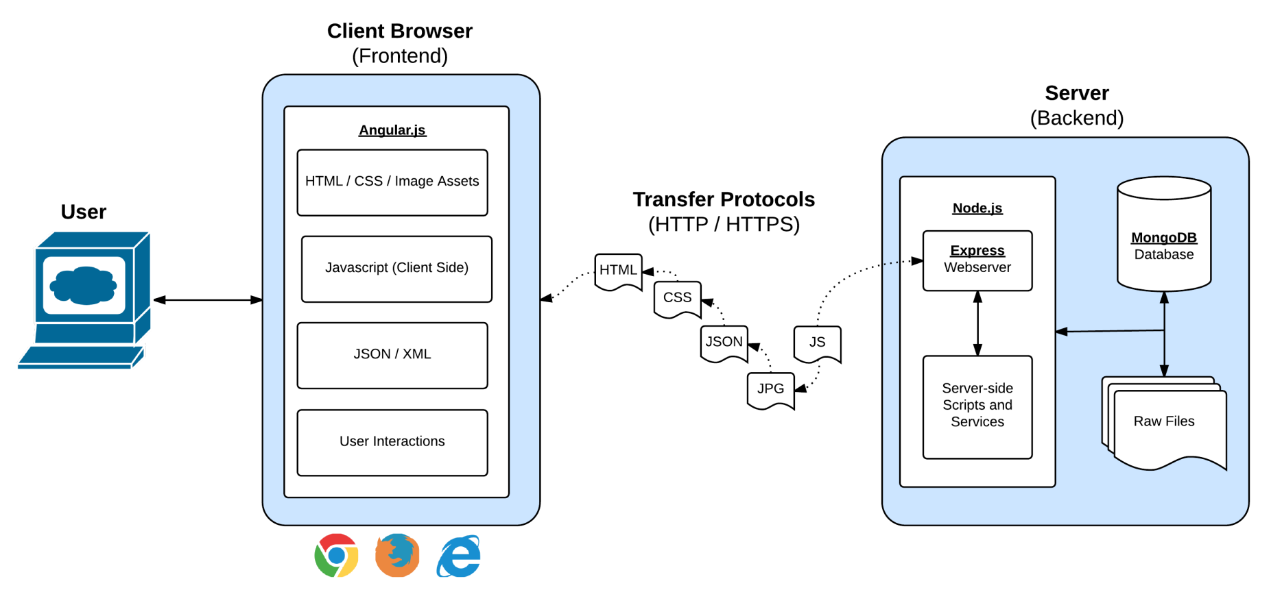
Full-Stack Development
React.js
In modern web applications there is a constant back-and-forth communication between the visuals displayed on the user’s browser (frontend) and the data and logic stored on the server (backend).

Slide 9
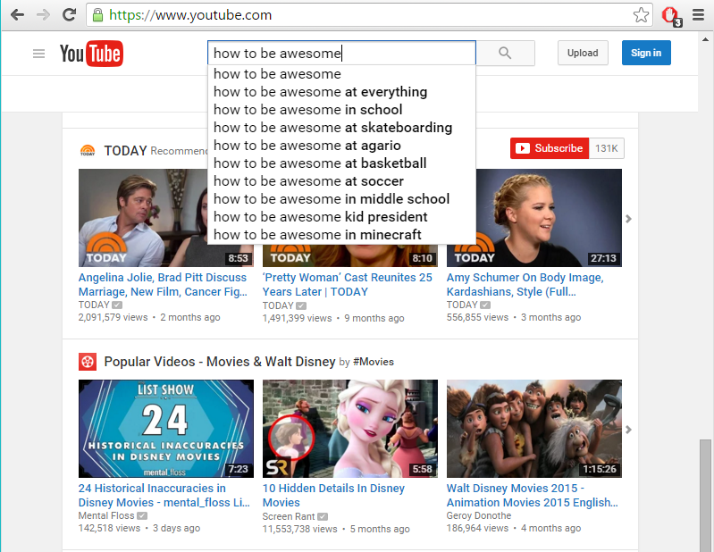
The “Magic” of YouTube

Slide 10
Key Question
Examples of “Server-Side” Code?

Slide 11
Server-Side Code in Action!
API that parse URL parameters to provide selective JSON
Firebase methods that provide a timestamp
Clicking an invoice that provides a PDF report
Image processing software that takes an image, applies a filter, then saves the new version
Google providing “results” relevant to your searches on other sites.

Slide 12
Critical Question
What is a “server”?

Slide 13
Definition of “Server”
A web server takes a client request and gives something back
“A web browser lets a user request a resource. The web server gets the request, finds the resource, and returns something to the user. Sometimes the resource is an HTML page. Sometimes it's a picture. Or a sound file. Or even a PDF document. Doesn't matter--the client asks for the thing (resource) [or action] and the server sends it back.”
“... When we say "server", we mean either the physical (hardware) or the web server application (software) [that actually runs the server commands]”
Kathy Sierra, Author of Head First Servlets and JSP

Slide 14
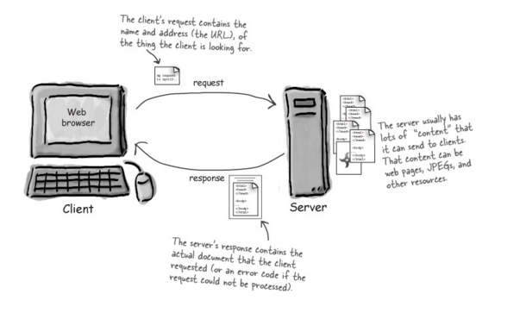
Server Definition

Slide 15
Definition of “Web Client”
Web clients let the user request something on the server and then shows the result (response) sent by the server.
When we talk about client, though, we usually mean both (or either) the human user and the browser application. The browser is the piece of the software that knows how to communicate with the server. The browser's other big job is interpreting the HTML code [sent by the server] and rendering the web page to the user.
Kathy Sierra, Author of Head First Servlets and JSP

Slide 16
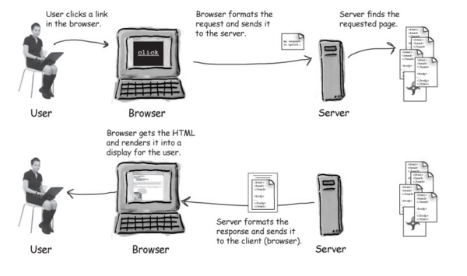
Web Client Definition

Slide 17

Alright. Relax.
You made it through the ultra important stuff!
You can go back to Facebook now
(But…. Not really, the next stuff is still important)

Slide 18
Node.JS

Slide 19
Key Question
So what is NodeJS?

Slide 20
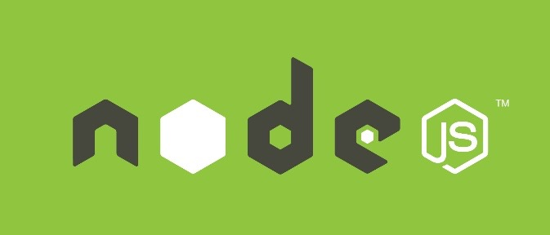
Definition of “NodeJS”
Node.js is an open-source, cross-platform JavaScript runtime environment designed to be run outside of browsers.
It is a general utility that can be used for a variety of purposes including asset compilation, scripting, monitoring, and most notably as the basis for web servers
A very rough definition of Node. Yay for sounding intelligent!

Slide 21
> YOUR TURN!!
Assignment
Take a few moments to research 5 companies that actively use NodeJS in production.

Slide 22
Why Use NodeJS as a Server?
It re-uses Javascript – meaning a front-end Javascript developer can also build an entire server themselves
It’s easily extendable. Numerous plugins exist to expand the capabilities of Node
Fast-implementation, which allows for the creation of an entire working server with only a few lines of code.
Single-Threaded Asynchronous Model – meaning it can handle multiple requests simultaneously and not get bottlenecked.

Slide 23
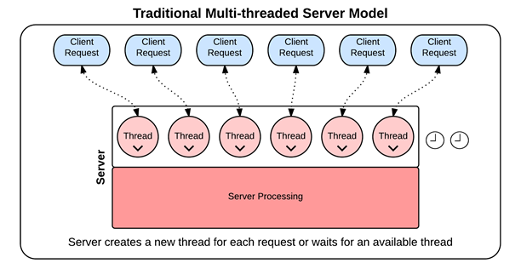
Synchrononous Threading
In traditional synchronous threading, each request requires its own thread. No other request can pass through that thread until complete. Since there is a limited pool of threads, this can create bottlenecks.

Slide 24
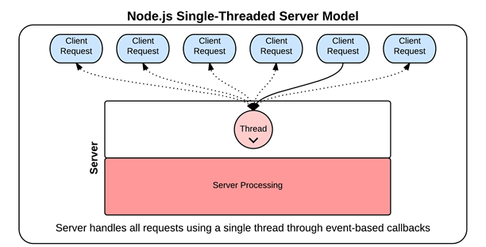
Asynchronous Threading (Node Way)
In Node-based asynchronous threading, a single thread is used throughout. Each thread is “put to the side” using callbacks and responded to when ready. Because of this, there is no limit on the number of requests that can be responded to and there is no bottleneck.

Slide 25
Coding Time!

Slide 26
Homework!

